Slide 1
Selenium
Date – 24th March 2023
SIMPLILEARN

Slide 2
What is Selenium
Selenium is a set of open-source web automation tools that leverages the power of web browsers and helps in automating workflows of how users interact with the web application within the browser. The primary purpose of Selenium, is - "Selenium Automates Browsers, What you do with this power is entirely up to you

Slide 3
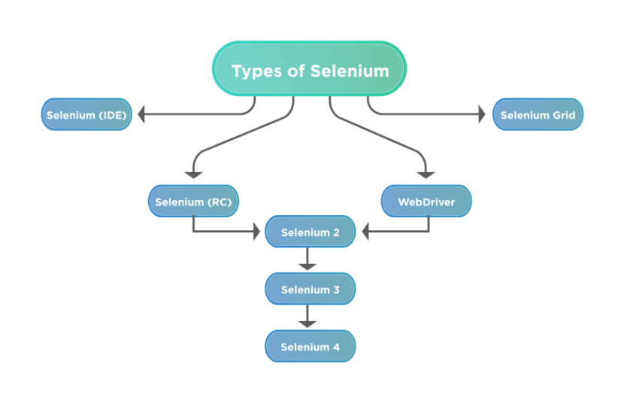
Components of Selenium

Slide 4
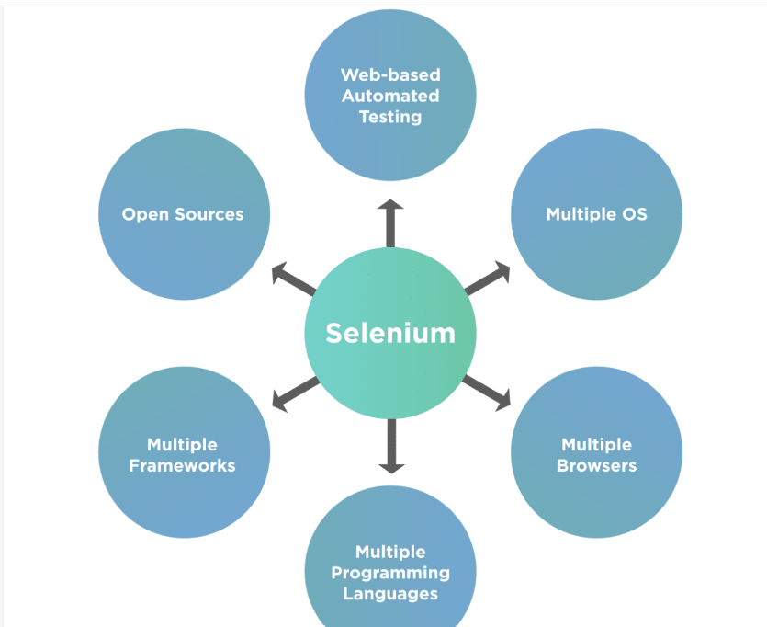
Advantages of Using Selenium

Slide 5
MAVEN Project SET UP in Eclipse
Idea on Maven
Maven Lifecycle
Idea of POM.xml
Overview on Type of Repositories
Dependencies in POM.xml
Advantages of Using Maven

Slide 6
Web Driver Browser Commands
driver.get(appUrl);
driver.getTitle();
driver.getCurrentUrl();
driver.getPageSource();
driver.close();
driver.quit();

Slide 7
Selenium Navigation Commands
driver.navigate().to(appUrl);
driver.navigate().forward();
driver.navigate().back();
driver.navigate().refresh();

Slide 8
Locators in Selenium
Locators in Selenium WebDriver provide mechanisms for identifying HTML elements on the page. Selenium supports a number of different web locators, and you have to choose the one that meets your test requirements.
Types of Locators in Selenium
ID
Name
ClassName
LinkText
Partial Link text
TagName
CssSelector
Xpath

Slide 9
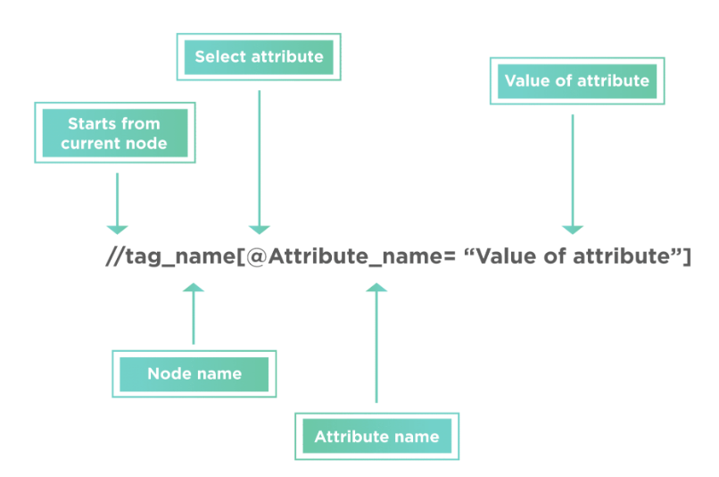
Syntax of Xpath
XPath finds any element within a webpage by using DOM. So, its syntax is also made up of DOM attributes and tags, as shown below:
XPath = //tag_name[@Attribute_name = “Value of attribute”]

Slide 10
Web Element Command
element.sendKeys("text");
element.click();
element.isDisplayed();
element.isEnabled();
element.isSelected();
element.submit();
element.getText();
element.getTagName();
element.getAttribute();

Slide 11
SeLECTING VALUES FROM A DROPDOWN
The Select class provides the implementation of the HTML SELECT tag. A Select tag provides the helper methods with select and deselect options. As Select is an ordinary class, its object is created by the keyword New and also specifies the location of the web element.
Select objSelect = new Select();
Different ways of Selecting values
selectByVisibleText
selectByIndex
selectByValue

Slide 12


JavaSCRIPT EXECUTOR INTERFACE
JavaScriptExecutor is an Interface that helps to execute JavaScript through Selenium Webdriver. JavaScriptExecutor provides two methods “executescript” & “executeAsyncScript” to run javascript on the selected window or current page.

Slide 13
Window Handle and Window Handles
getWindowHandle( ): When a website opens, we need to handle the main window i.e the parent window using driver.getWindowHandle( ); method. With this method, we get a unique ID of the current window which will identify it within this driver instance. This method will return the value of the String type.
Syntax – driver.getWindowHandle()
getWindowHandles( ): To handle all opened windows which are the child windows by web driver, we use driver.getWindowHandles( ); method. The windows store in a Set of String type and here we can see the transition from one window to another window in a web application. Its return type is Set
Syntax – driver.getWindowHandles()

Slide 14
Pop Ups and Alert in Selenium
Alerts are small popup boxes/windows which display the messages/notifications and notify the user with some information seeking some permission on certain kinds of operations. Additionally, we can also use them for warning purposes. Sometimes, the user can enter a few details in the alert box as well.
Types of Alerts
Simple alert:
Prompt Alert
Confirmation Alert:

Slide 15
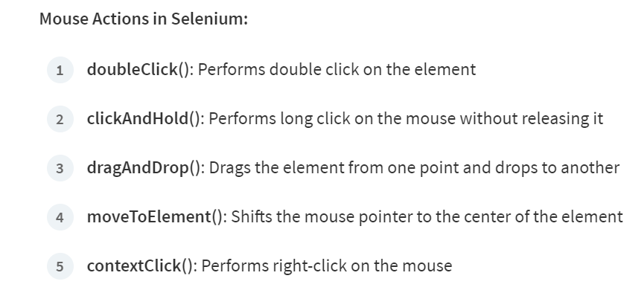
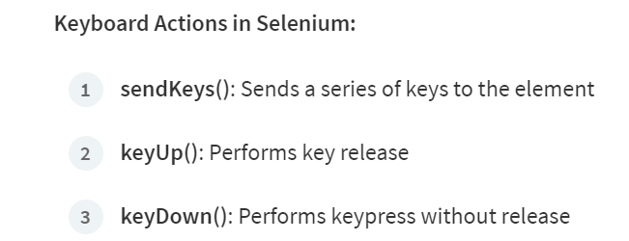
Action Class in selenium
Actions class is an ability provided by Selenium for handling keyboard and mouse events. In Selenium WebDriver, handling these events includes operations such as drag and drop in Selenium, clicking on multiple elements with the control key, among others. These operations are performed using the advanced user interactions API. It mainly consists of Actions that are needed while performing these operations.

Slide 16
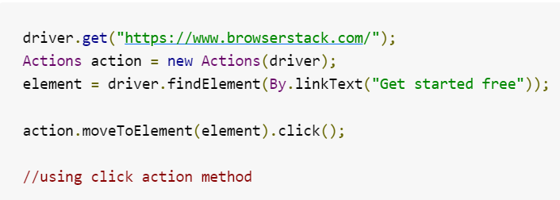
CODE snipper for action class

Slide 17
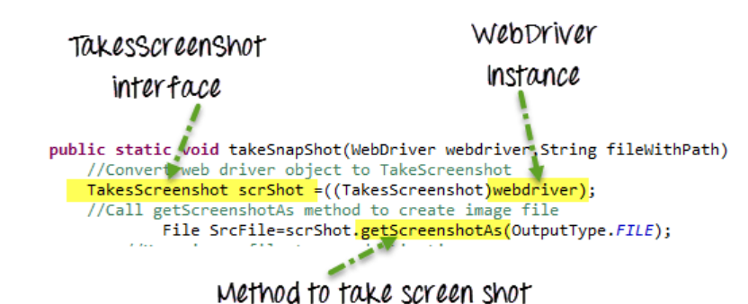
Taking screenshots in selenium
A Screenshot in Selenium Webdriver is used for bug analysis. Selenium webdriver can automatically take screenshots during the execution. But if users need to capture a screenshot on their own, they need to use the TakeScreenshot method which notifies the WebDrive to take the screenshot and store it in Selenium.

Slide 18
Types of wait in selenium
Static Wait
In UI automation, waits are required because certain elements get loaded on the page asynchronously, so after triggering an event a page may get loaded successfully but some of its elements may still not get loaded. This causes elementNotFound exception while locating the element. In such cases, we are left with using Thread.sleep() i.e. a static wait that will halt the test execution for some specified time and then perform the next step.

Slide 19
Types of wait in selenium
Dynamic Wait
It is a concept of the dynamic wait which waits dynamically for specific conditions.
Implicit Wait
Explicit Wait
Fluent Wait

Slide 20
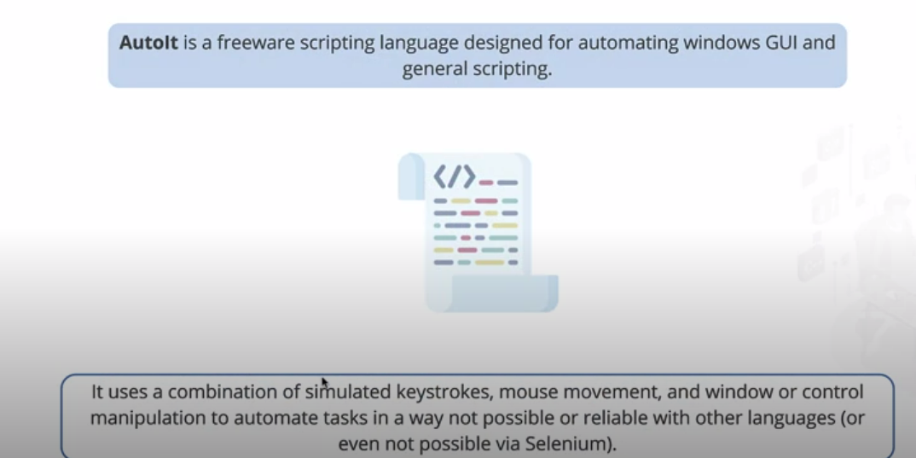
Auto it

Slide 21
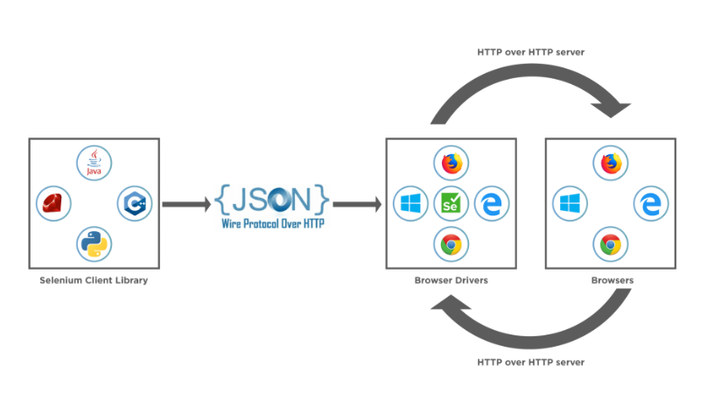
Webdriver architecture
Components of WebDriver Architecture
Selenium WebDriver Client Libraries / Language Bindings –
JSON WIRE PROTOCOL
Browser Drivers
Browsers

